Slide 1
Garments
Management System
1405072
1405075
1405079
1405086
1405087
Student ID:

Slide 2
Requirement Analysis
Detecting Problems

Slide 3
Material
Method
Error Prone
Error Prone
No Default Solution
Non-efficient Method
No Digital Storage
Non-efficient Method
Low-quality Materials
Insufficient Incentive
Data Organization Problem
Lack of Maintenance
Lack of Training
Lack of Digitalization
Lack of Awareness
Lack of Enforcement
Lack of Ethics
No Standard Policy
Humane Error
Policy
People

Slide 4
Material
Method
Progress Tracking
Material Loss
Huge Amount
Lack of Prediction
Management Problem
No analysis
Lack of Skills
Lack of Enforcement
Lack of Awareness
Humane Error
Policy
People

Slide 5
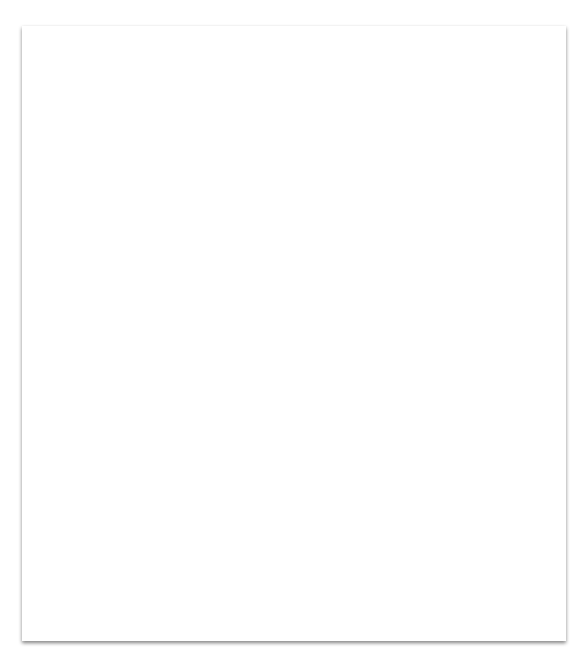
Functional Requirements
Sub Systems
Informations storing.
Orders Placements.
Work Distribution.
Supplier Notification.
Managing Material Records.
Progress Tracking.
Shipment of Products.

Slide 6
Non-Functional Requirements
Security
Legal and business
Usability and training
Reliability and quality assurance
Implementation and technical constraints
Interfaces
Operation and physical environment

Slide 7
Use-Cases for Storing Information
Use Case | Actors
Fill the forms using manual data | Officer, Service Manager
Approve data | Service Manager, Board of Directors
Update and analyze data | Officer, Service Manager
Create account for new Clients, Officers, Manager and Board of Director members | Officer

Slide 8
Use-Cases for Placing Orders
Use Case | Actors
Place orders specifying type, design and amount and other specification | Client
Specify cost and deadline | Finance Manager, Production Manager
Approve order | Client, Service Manager

Slide 9
Use-Cases for Work Distribution
Use Case | Actors
Save information of work distribution by filling forms | Production Manager

Slide 10
Use-Cases for Supplier Notification
Use Case | Actors
Place orders for materials | Service Manager
Record after receiving ordered materials | Service Manager

Slide 11
Use-Cases for Progress Tracking
Use Case | Actors
Give update about production after a particular interval | Production Manager
See the update about production | Client

Slide 12
Use-Cases for Material Management
Use Case | Actors
Manage and update material information related to production | Production Manager
Manage and update material information related to garment’s services | Service manager

Slide 13
Use-Cases for Delivery
Use Case | Actors
Notify client about work completion | Client, Service Manager
Confirm payment | Client, Finance Manager
Arrange shipment | Service Manager
Confirm receiving and provide feedback | Client

Slide 14
Let’s see a prototype of our system.
Thank you.

